Slide 1
Chapter No.2 Computer Buses

Slide 2
Computer Bus
Bus is a group of conducting wires which carries information, all the peripherals are connected to microprocessor through Bus.

Slide 3
Types of buses
There are two types of buses:
System Bus
Expansion Bus

Slide 4
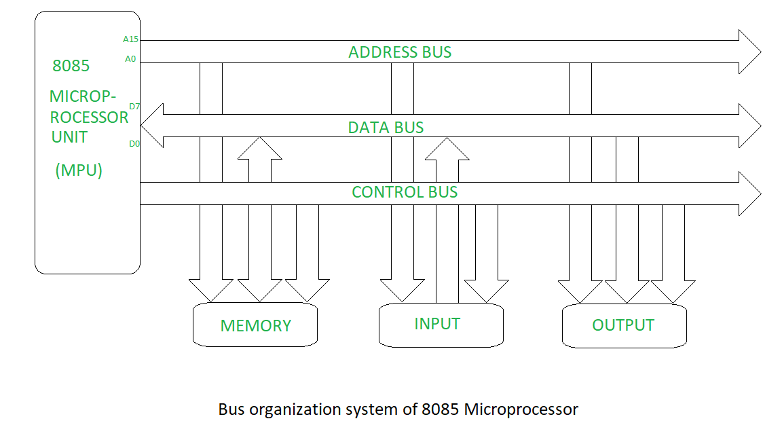

Slide 5
System bus
This is the bus that connects the CPU to main memory on the motherboard. The system bus is also called the front-side bus, memory bus, local bus, or host bus.

Slide 6
Types of System Bus
There are three types of system buses in computer architecture
Address bus
Data bus
Control bus

Slide 7
Address bus
Address bus is unidirectional bus and always address is sent from processor to memory only and address bus pass address to memory and memory activate particular memory cell.

Slide 8
Data bus
Data bus is bidirectional , it flow data between processor and memory, it only tasks is to provide data from memory to processor or from processor to memory.

Slide 9
Control bus
Control bus is bidirectional responsible for flow of control function function between processor and memory like interrupt, read and write status information of processor whether it want to read or it want to write memory etc.

Slide 10
Expansion bus
A number of I/O Buses, (I/O is an acronym for input / output), connecting various peripheral devices to the CPU. These devices connect to the system bus via a ‘bridge’ implemented in the processors chipset. Other names for the I/O bus include “expansion bus", "external bus” or “host bus”.

Slide 11
Types of Expansion Bus
These are some of the common expansion bus types that have ever been used in computers:
ISA - Industry Standard Architecture
EISA - Extended Industry Standard Architecture
MCA - Micro Channel Architecture
VESA - Video Electronics Standards Association
PCI - Peripheral Component Interconnect
PCMCIA - Personal Computer Memory Card Industry Association (Also called PC bus)
AGP - Accelerated Graphics Port
SCSI - Small Computer Systems Interface

